Slide 1

Welcome To
Byte Achievers
Alex Charity

Slide 2
About us
The Computer Science program aims to prepare students to design and create algorithmically complex software and develop new and effective algorithms to solve computing problems, design and implement software, and devise new ways to use computers.

Slide 3

My Logo

Slide 4
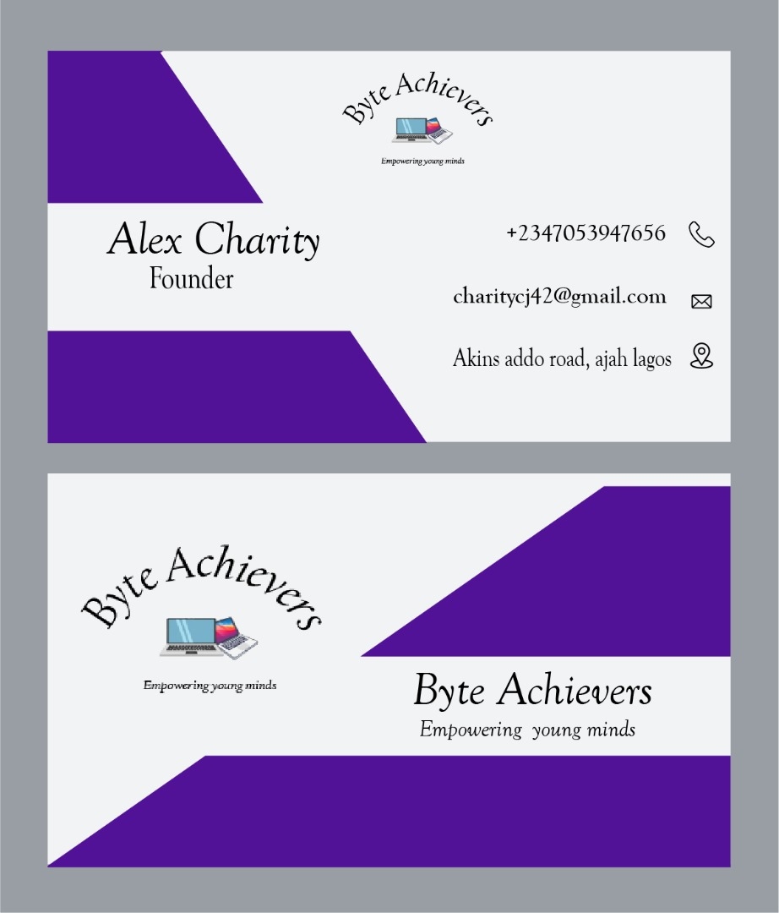
My business card

Slide 5
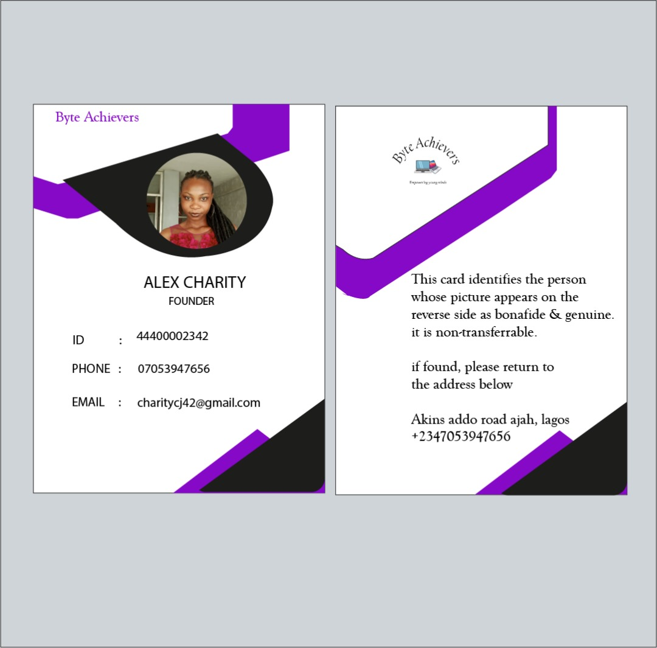
My id card

Slide 6

My business flyer

Slide 7
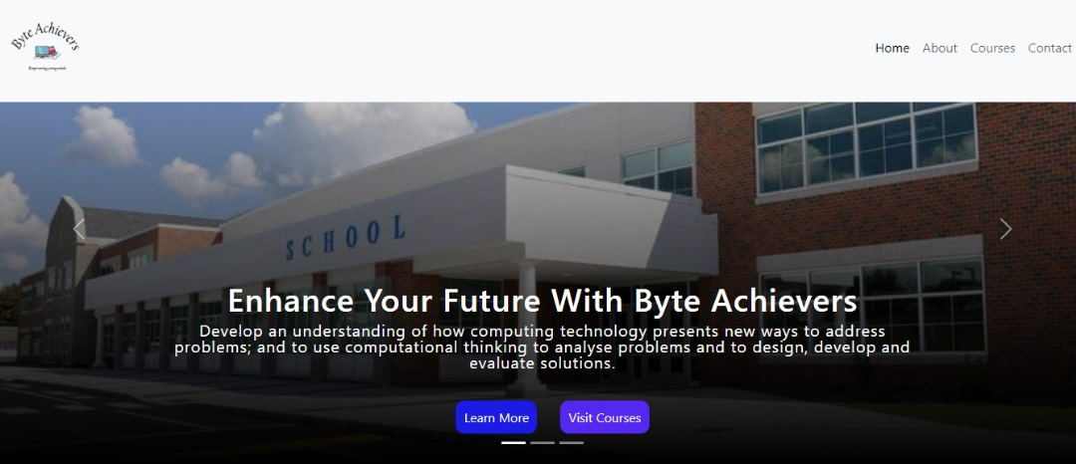
My web design

Slide 8

Thank you

